Slide 1
World History and Geography
Deeds of the Lord
Throughout World History
Extracted from His Saint’s Stories

Slide 2
An Introduction to TeamsWin Strategy
People Places Things and Events - Strategy
Who What Where When and Why – Strategy
Definitions – Strategy
Bible People Places Things and Events – Strategy
The Book of Acts Continued to Our Time - Strategy
A History of the Church North South East and West, the Whole World
Examples of what you will see – screen shots
How to use your computer to see it – Google Earth

Slide 3
How to handle Google Earth
Download free app or Google Earth program from Google: https://www.google.com/earth/about/versions/ for example.
So, you can bring a Google Earth File (.kmz) into your Google Earth Program or app, search for file association for your computer or phone and follow directions.
You probably already have a pdf file reader; if not, search for a free Adobe PDF Reader and download. Adobe, because some readers do not handle links.
Plus, If you can’t see something in a list just hover over it and your browser will show you the whole file name. Then, read back from the end of the name.

Slide 4
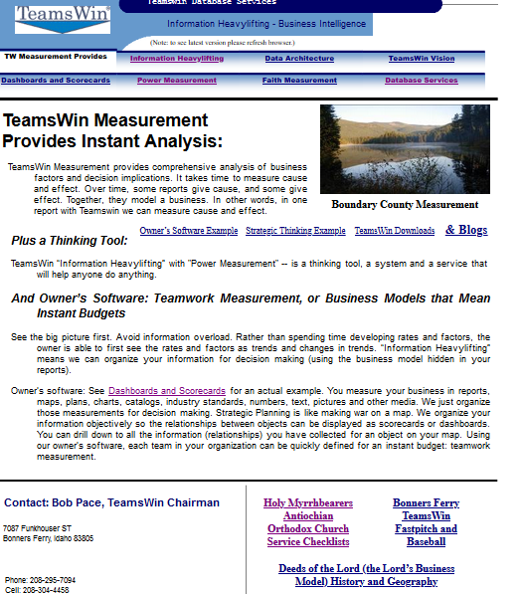
Screen Shot of TeamsWin.net
From TeamsWin.net there are 3 ways to get to World History and Geography:
Strategic Thinking Example,
Blogs
Deeds of the Lord
However, I am looking for others to build nice websites that connect to my content. World History and Geography Content for example.

Slide 5
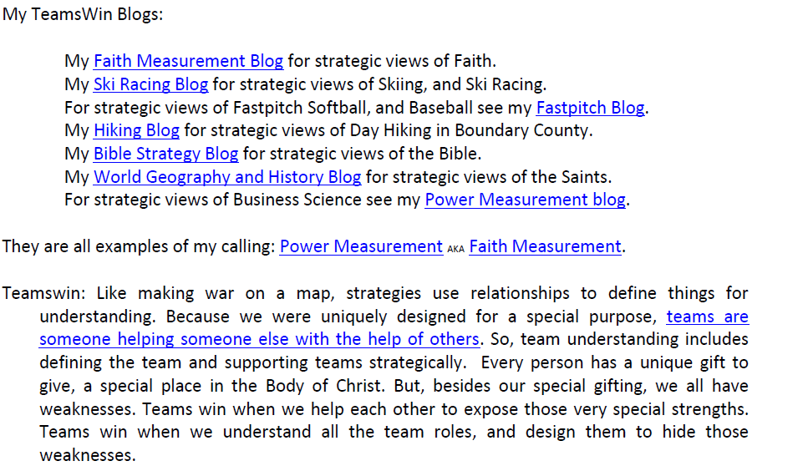
Blogs
The World Geography and History Blog description includes the Bible Strategy Blog, or the 50 People and 50 Places that are in more than one book of the Bible.

Slide 6
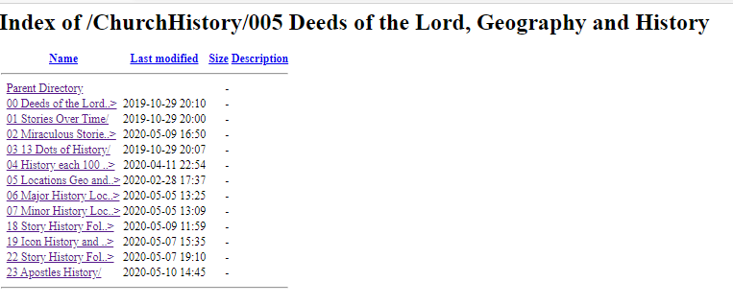
Deeds
This list will grow.
Now that I have everything in a relational database, I can look at the stories from an unlimited number of views.
The true understanding of scripture comes from both seeing how the Saints lived it, and then living it.
Because each story has over 100 datapoints. there are currently over 100 of these queries, which can be combined for interesting relationships. So more to come.

Slide 7
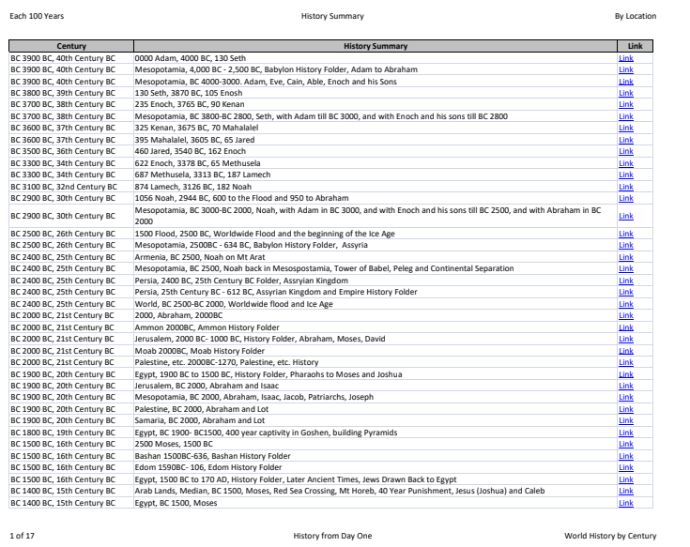
World History Summary with Links
Only 17 pages for a summary of World History East West North and South, Probably never before compiled.
The Links drill down to the history and geography for that location

Slide 8
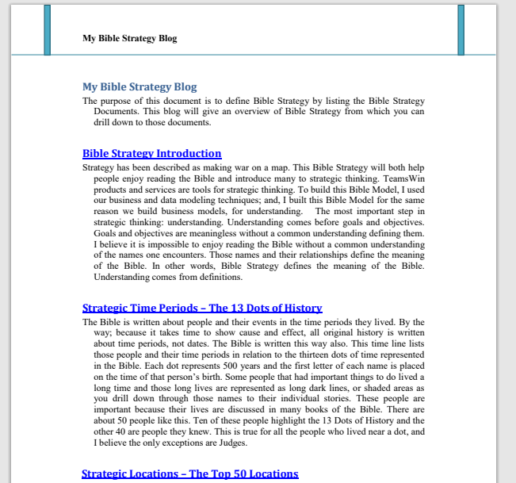
Bible Strategy Introduction
Zoom the introduction box so everyone can read

Slide 9
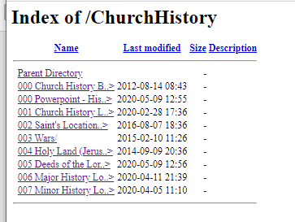
World Geography and History
000 1 PowerPoint
000 2 Blog
000 3 How to read History
005 Deeds of the Lord Queries

Slide 10
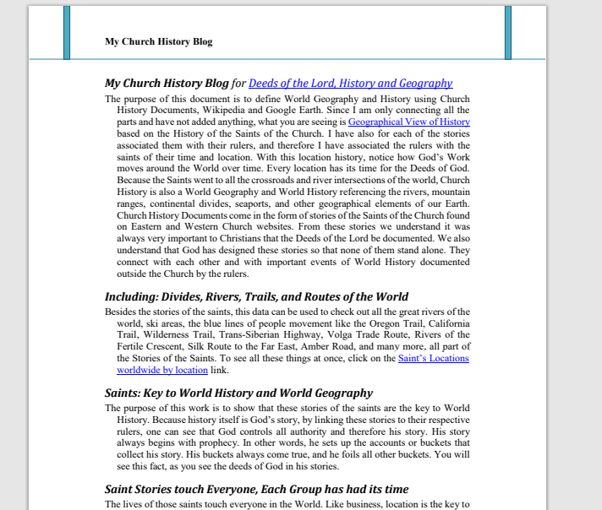
Church History Blog
Zoom the purpose box so everyone can read.

Slide 11
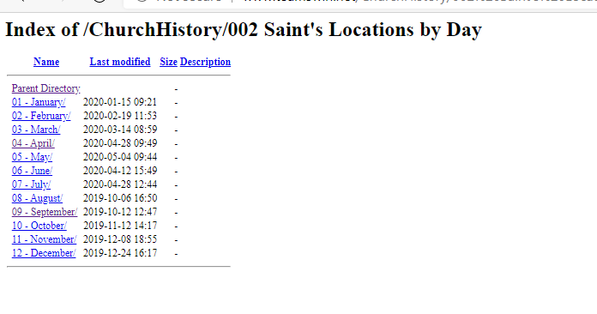
Saints Locations by Church Calendar Day
I go to this page every day to read the day’s stories both East and West.
All but two Miracles have been removed from the Western stories.

Slide 12
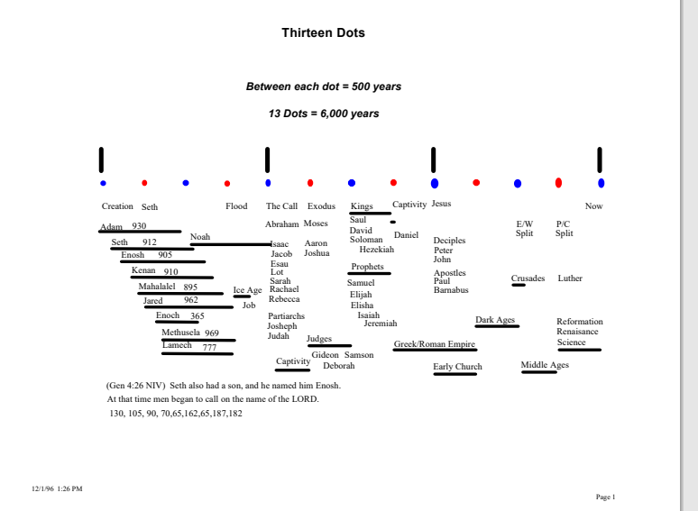
13 Dots of History

Slide 13
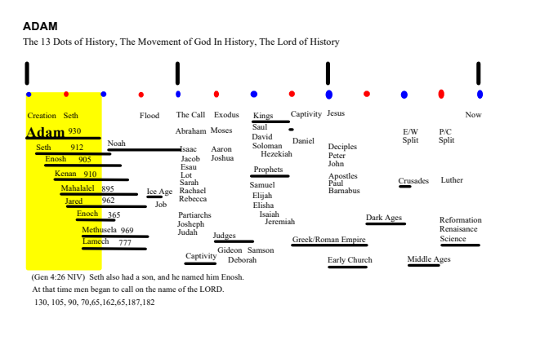
Adam, created complete, passed it on
Besides naming all the animals, Adam taught these 8 people what he knew when he was created complete. Here you see he lived with each of them for at least 300 years.
Thanks to Indiana Jones, his friends, and the Nazis: In the 20th Century we discovered Adam knew how to fly and make aluminum with electricity.

Slide 14
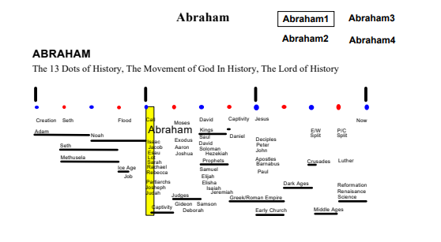
Abraham, lived with Noah and his Sons
Here you see Abraham’s life begins when Noah’s ends.
Here you see that of the 50 people that recur throughout the Bible, many are associates of Abraham.
On the website you will be able to drill down to Abraham 2-4.

Slide 15
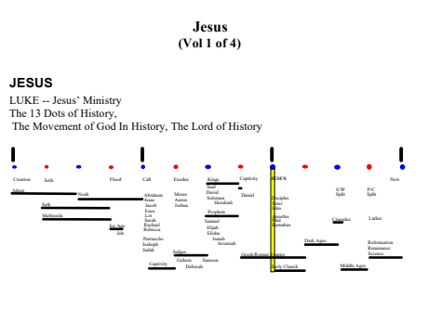
Jesus
After his death, The Holy Spirit through “The Apostles” showed us Jesus is the point of the Bible.
Here we see how Jesus is one of the 10 people around which the story line of the Bible is based.
From each of these 10 people we can drill down to their historical stories with abstracts of the Geography.
Like Sunday School, the stories of these 10 people and the 40 people they knew should come before attempting reading the Bible.

Slide 16
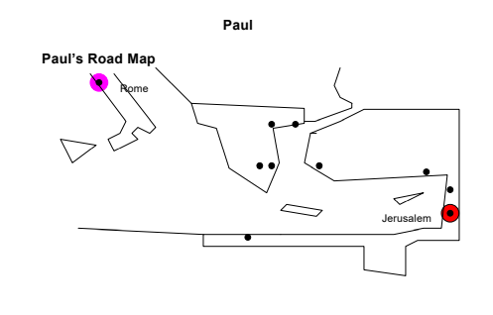
Paul
This is an example of the geography abstracts used to see the 50 locations that recur in the Bible.
Created before the invention of it, these abstracts are handy even now before we begin using Google Earth.

Slide 17
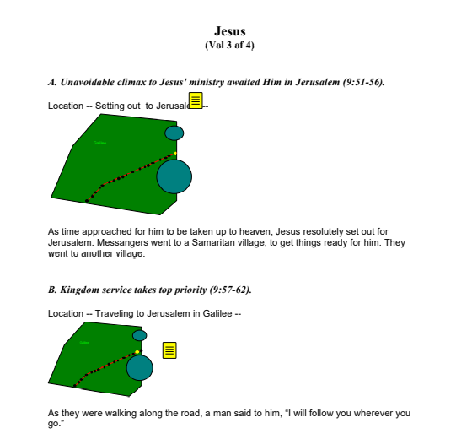
Jesus’ Path to Jerusalem, 19 stories of Galilee
These are abstracts of Galilee.
On the way back to Jerusalem, there were 19 stories in Galilee, 17 in Samaria and 9 in Benjamin on the way up and in to Jerusalem.
The little dots across Galilee represent the stories and the yellow boxes are where we can drill down to the full text.

Slide 18
Geography and History Navigation
Index of /ChurchHistory/002 Saint's Locations by Day/06 - June/0619 - Venrbl Paisius oH&B (my Saint)
Story
1 Geography Folder
2 HF
3 Continental Divides
Bulgaria, 1742-1773, Paisius of Hilander & Bulgaria, Historian, National Awakening
Reading the story is easy, but training your eye to read the Geography and History may take some practice. The key to understanding: seeing the repetitions. First, there are items that do not repeat, they are the locations mentioned in the story. The name of the location will indicate the location folders needed to understand the location. Like a dictionary, understanding could be thought of as connecting lists; in other words, knowing the list an item is in, the other items in that list, and (like branches of a tree), the lists the item is under, produces understanding. In the geography and history repeating items, we have lists (and trees) of locations and lists (and trees) of history time periods. So, once you look for the repetitions, you can easily see the story locations, the geography folders for those locations, and the history folders for the story. Lists give you relationships for understanding with very little text. And lately (2021) I have been adding little notes to each item, their sibling items, that roll up into the notes for the folders above. With these notes, the interconnected lists are very powerful. This relational approach (with little text) produces, I believe, the best history in the world.

Slide 19
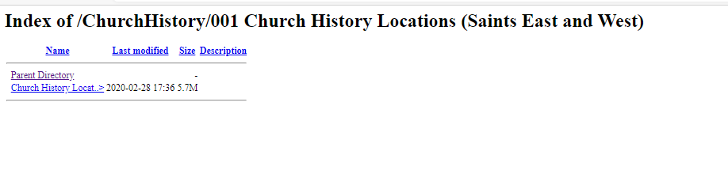
Locations – One Big File with All the World History and Geography
Click Here

Slide 20
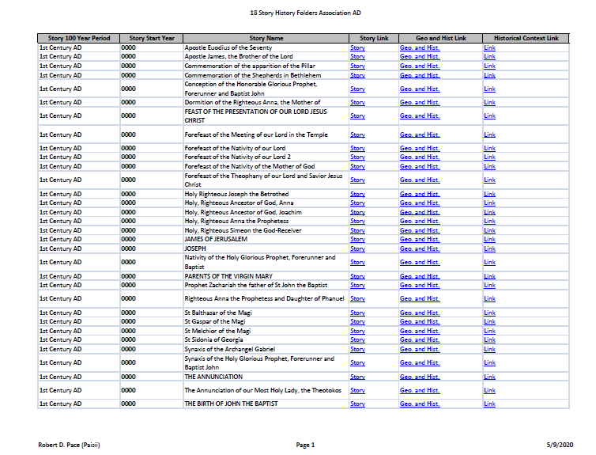
Saint Stories over Time with Historical Context
The Historical Context is what was going on around the World that century.
The Stories are sorted by start date and then alphabetically
With links to Stories, Geo. and Hist, and Historical Context.
Currently, Historical Context takes over 70 queries, too hard to refresh until I figure another way. So, I deleted them.

Slide 21
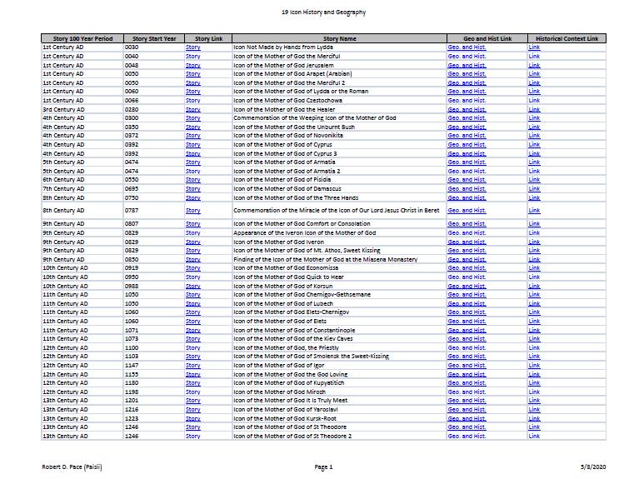
History of Icons
These Icon stories tell us what Mary Mother of God (Theotokos) has been doing for the past 2000 Years.
Besides being Queen of Heaven, these stories are why her picture is foremost in our Church.
With links to Stories, Geo. and Hist, and Historical Context.

Slide 22
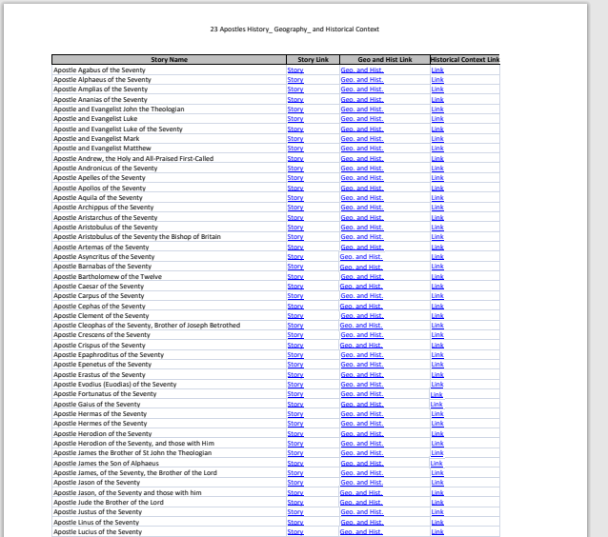
Apostles History, Geography, and Context
All Orthodox Christian Theology comes from the Apostle’s knowledge of Old Testament prophecy.
So, we are the only “Apostolic Church”.
Luther did not find fault with “The Apostles” Theology, but the false theology added by the Roman Church after they became the first denomination.
For example: Through James, Jesus’s step-brother, the Holy Spirit gave us our church service.
So, our only theologians are a bunch of unrefined fisherman, carpenters. and tax collectors.

Slide 23
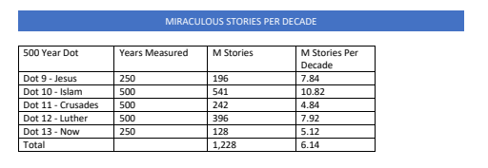
The History of Miracles
Except for a little uptick in the Dark Ages, they haven’t even slowed down.
Almost just as many now as the Early Church, and the other (500 year) periods.
There are millions of miracles within these stories.

Slide 24
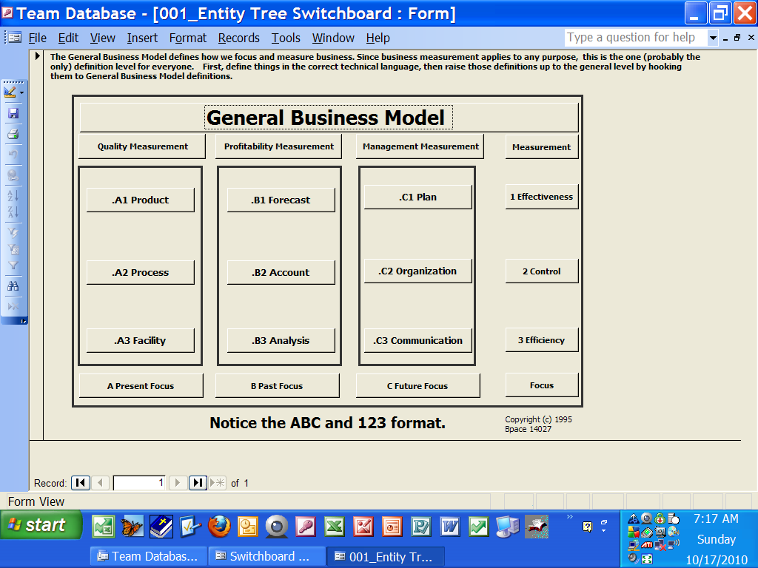
What is this?
This is the entry form to a database that organizes business science subjects. This is where you drill down to the detail in those subjects. In other words, the classes you take in business school fit in one and only one of these nine boxes. I discovered this pattern while organizing the information passing between computing programs at a large company, over 100 systems. They each have their own architecture. For the same reason, Each system also fit in only one of these nine boxes. Therefore, This is the General Business Model, true for any business.

Slide 25
A Review of TeamsWin Strategy
Definitions – Strategy
People Places Things and Events -- Strategy
Who What Where When and Why – Strategy
God’s Business Model – Definitions -- Strategy
Bible People Places Things and Events – Strategy
The Book of Acts Continued to Our Time -- Strategy
Church History, the Whole World, -- Strategy

Slide 26
World History and Geography
Deeds of the Lord
Throughout World History
Extracted from His Saint’s Stories
The Lord’s Business Model
The Lord’s Strategy
The Lord’s Definitions
The Lord’s People, Places, Things, and Events
The Lord’s Who, What, Where, When and Why

